Slide 1
TODO LIST WEBSITE

Slide 2



TEAM INTRODUCTION:
OBJECTIVES OF THE PROJECT:
To build a portal for creating Todo List where users can get their work done consistently and make their lives more productive and well organized.
SUDEEPA T
SHWETA BHALKE
PRAJWAL I

Slide 3
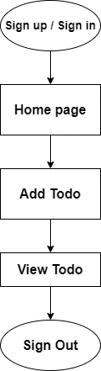
PRESENTATION LAYER:
The portal provides ability to signup/login. Once user signup in
the portal, a JWT authorization is provided which generates a
JWT certifying user identity and Resource server decodes and
verifies the authenticity of the token.
After SignUp/SignIn we can add todos with the target date.
In View Todo page, we can see the details of all todos and we
can also update and delete the todos.

Slide 4
BUSINESS LOGIC LAYER
When the user creates the new task with target date, data of task and target will be date stored in
the database.The task and target date will be displayed in view todo page.
Once the todo is created, we can update, mark as competed and delete the data. Which will be
concurrently updated in the database.
When we mark todo as completed the task colour will be changed into green and the task is
crossed out.
If user will not completes the todo within target date , the todo colour will be changed to red.
User can check the status of their todo tasks at anytime, anywhere and can update their tasks.

Slide 5
DATA LAYER
User email Id & password is stored in a User_table in the database.
User todo task, target date , status of the task is stored in another Todo_table in
the database.
Password is saving in encrypted form so that the user privacy and security is safe
using Password Encoder.
If task is completed it return 1 in the table, if task not completed it returns 0.

Slide 6
BOUNDARY CONDITIONS
#1
Each user will have the ability to create 20 Todo tasks.
#2
Email ID should be in valid email format and Password should be
more than 8 alpha-numeric characters.
User cannot register multiple times with same email id.
#3

Slide 7
TECHNOLOGIES USED
Spring Boot
MYSQL
REACT JS
VERSION: 2.3.5
Reason:
To make it easier for faster and more efficient development ecosystem.
Embedded server to avoid complexity in application deployment
VERSION: 8.0
Reason:
It is an open-source and freely available database system.
MySQL is a platform independent. i.e. compatible to use on any platforms.
VERSION: 17.0.1
Reason:
React is the open-source JavaScript library to build web applications.
One of the main benefit of using React JS is its potential to reuse components.
Notes:
<a href='https://www.freepik.com/vectors/event'>Event vector created by stories - www.freepik.com</a>

Slide 8
ONE FEATURE WANT TO HIGHLIGHT:
Users can manage their ToDo tasks by categories like….
All ToDos
Completed ToDos
Not Completed ToDos

Slide 9
FUTURE DEVELOPMENT
Pop up notification when Todo task expire.
Priority based Todo tasks, high priority tasks should be pinned on top of the list.

Slide 10
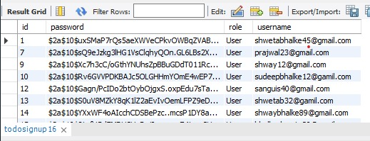
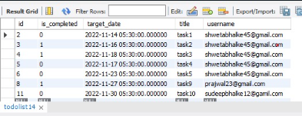
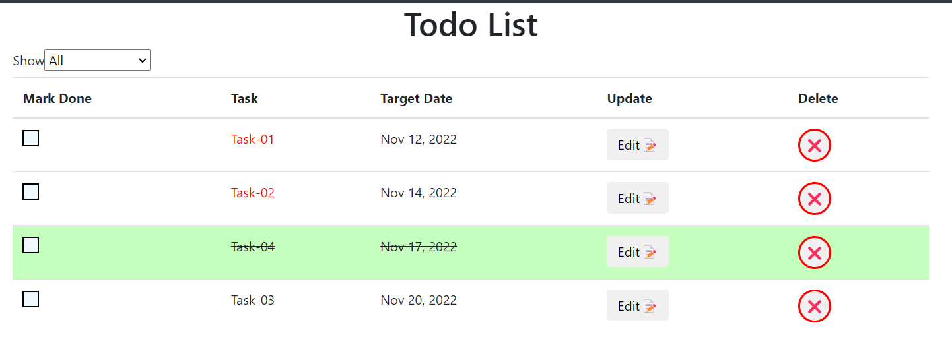
TESTING OF THE CODE
point

Slide 11

LESSONS LEARNT
Analizing the problem statements, planning, and implementation .
Designing front end part and interfacing it with the backend database.
Communicate as much as possible to reap the most out of the benefits of teamwork.

Slide 12
THANK YOU

